Slide 1

Introduction to Hadoop

Slide 2
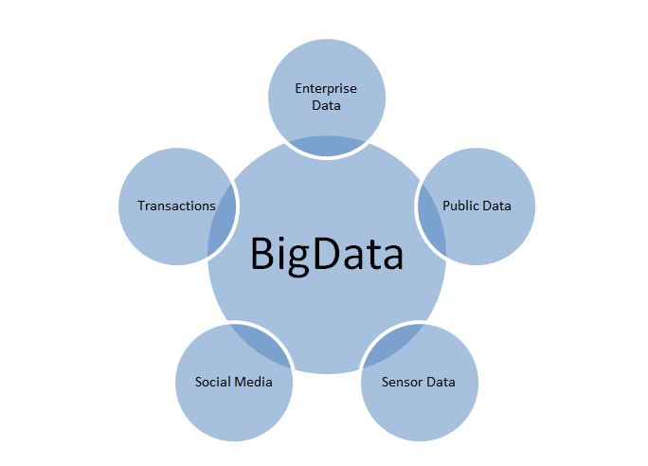
BigData : Volume, Velocity, Variety
What is BigData ?
- Twitter (over 7 TB/day )
- Facebook (over 10 TB/day)
- Google (over 20 PB/day)
- Aerial sensory technologies (remote sensing)
- Software logs, cameras(images/videos), microphones(audios)
- Radio-frequency identification readers
- Wireless sensor networks
90% of existing data in the world has been created in the last two years only.

Slide 3
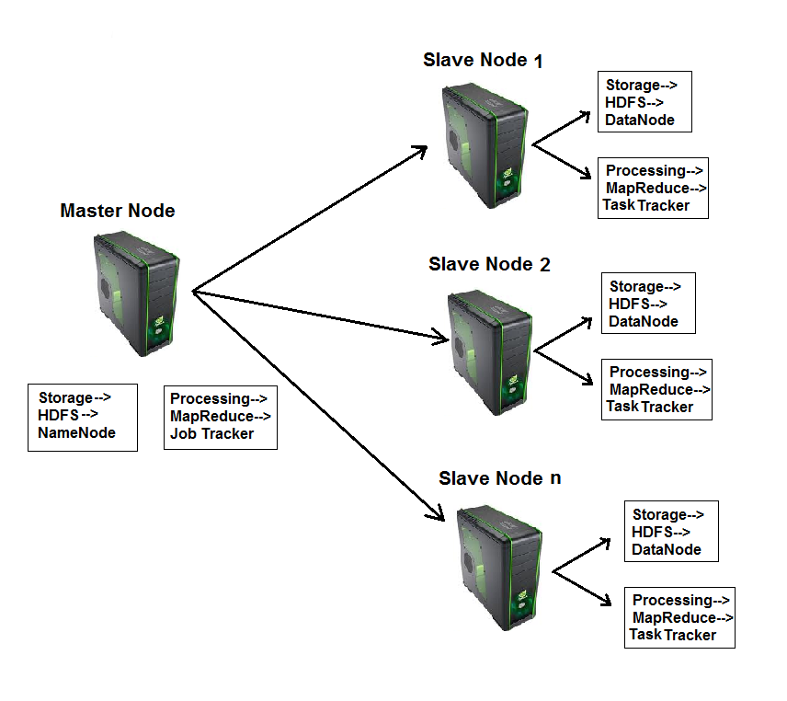
What is Hadoop?
Hadoop is a framework that facilitates functioning of several machines together to achieve the goal of storage and analyzing large sets of data.
Hadoop makes data mining, analytics, and processing of big data cheap and fast.

Slide 4
Components of Hadoop :
  Hadoop consists of two core components
1. The Hadoop Distributed File System(HDFS)
- HDFS is responsible for storing data on the cluster of machines.
- Data is normally split into 64MB to 128MB blocks and spread across the cluster.
2. MapReduce
      - MapReduce is data processing component of Hadoop.
      - Consist of two phases :
      1. Map
      2. Reduce

Slide 5
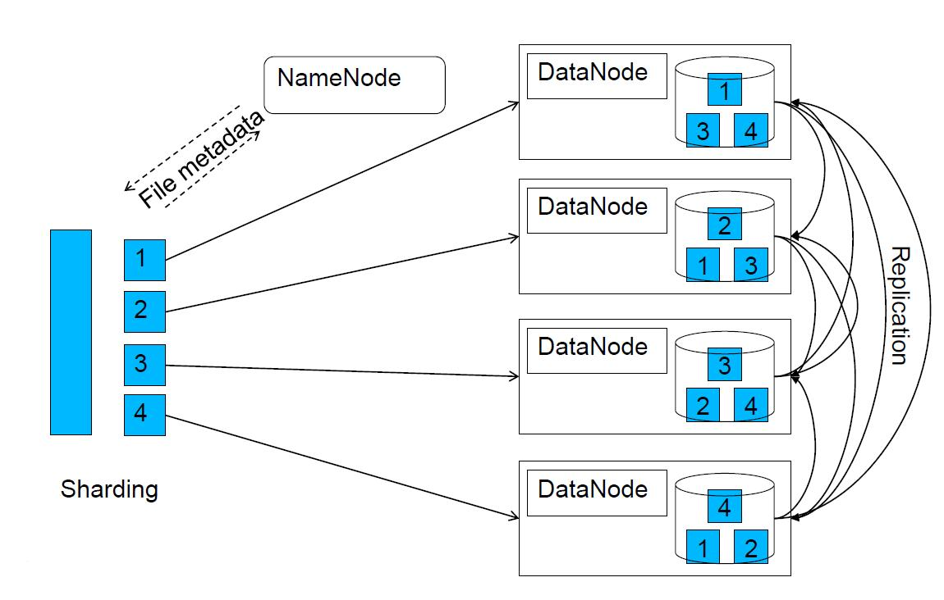
Hadoop Distributed File System(HDFS)
By default, each block(64MB to 128MB) is replicated 3 times. The replication factor can be changed through configuration settings.

Slide 6
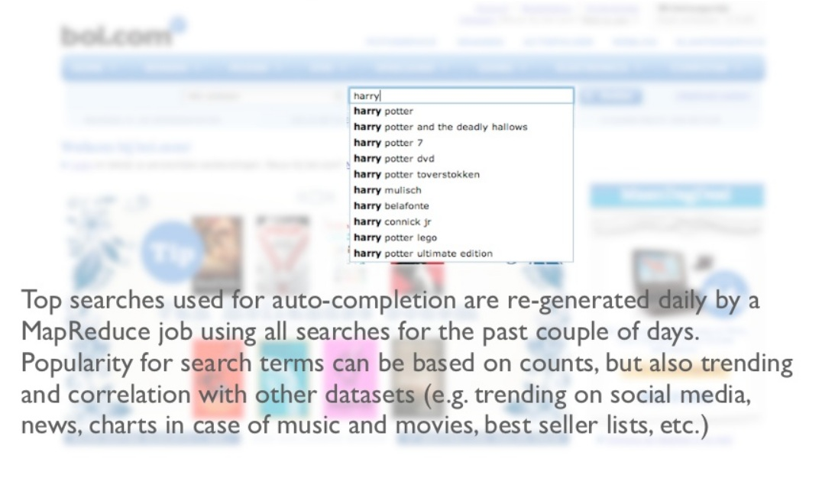
Some Real Time Examples : MapReduce

Slide 7
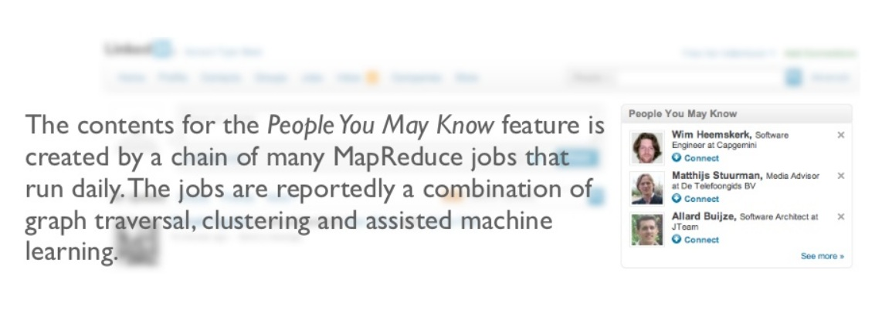
Continues…

Slide 8
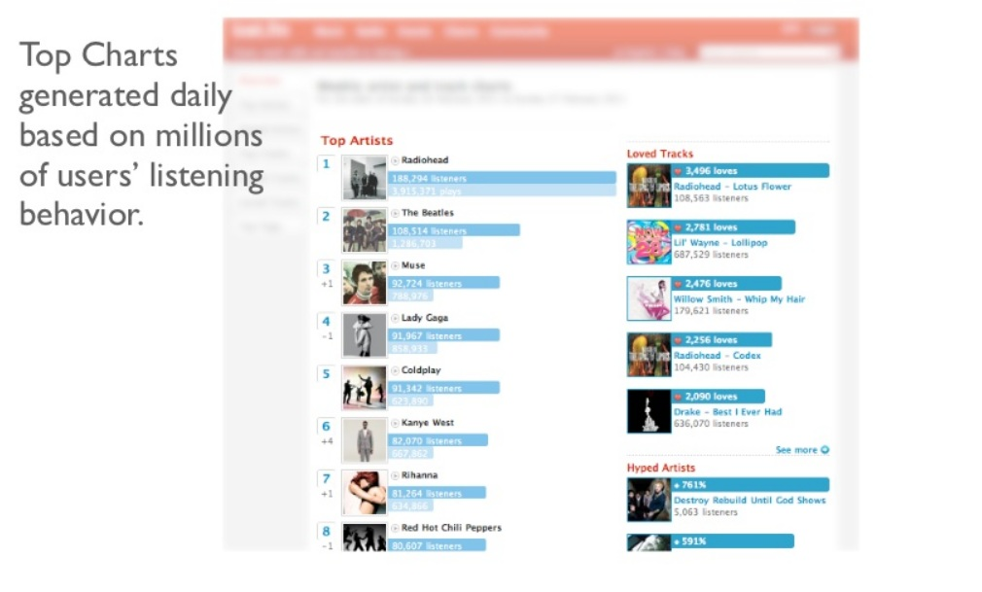
Continues…

Slide 9
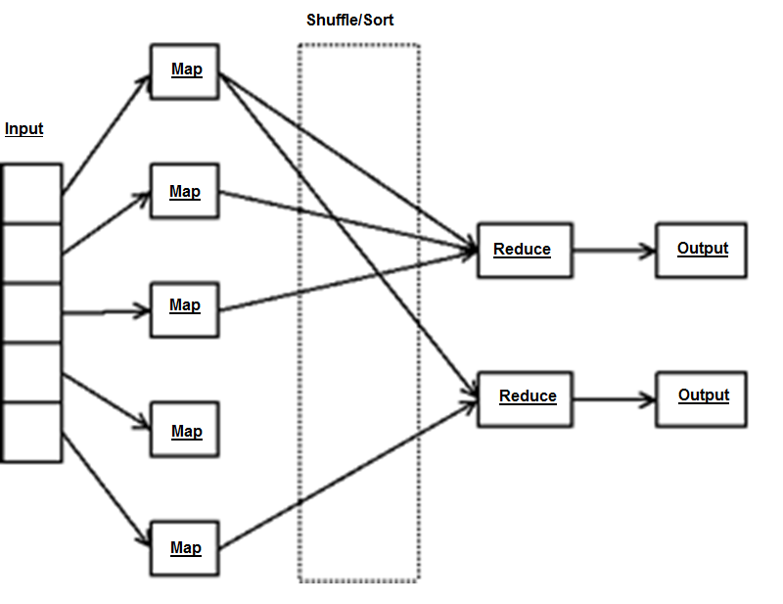
Programming Model : MapReduce

Slide 10
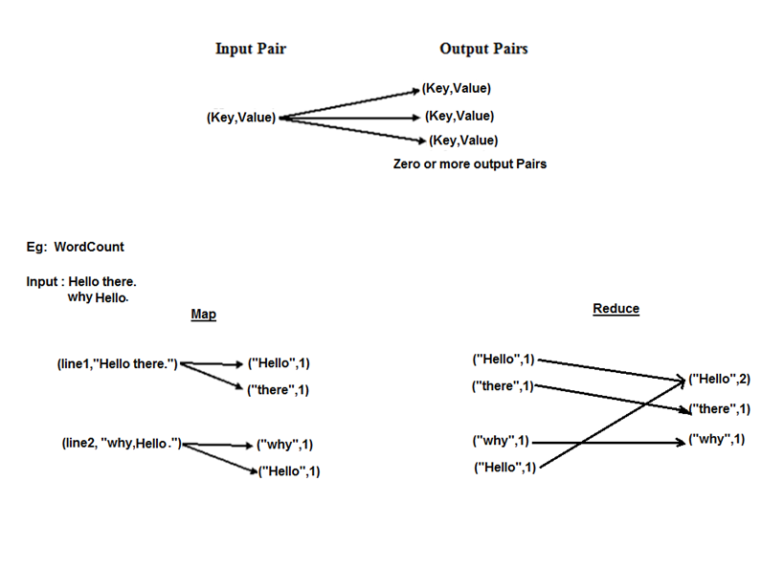
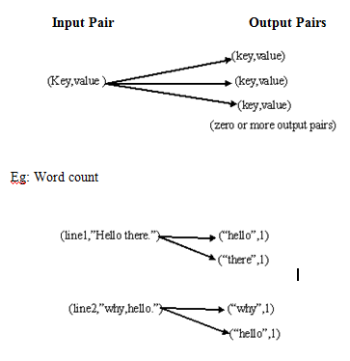
Programming Model : Key-Value Pair

Slide 11
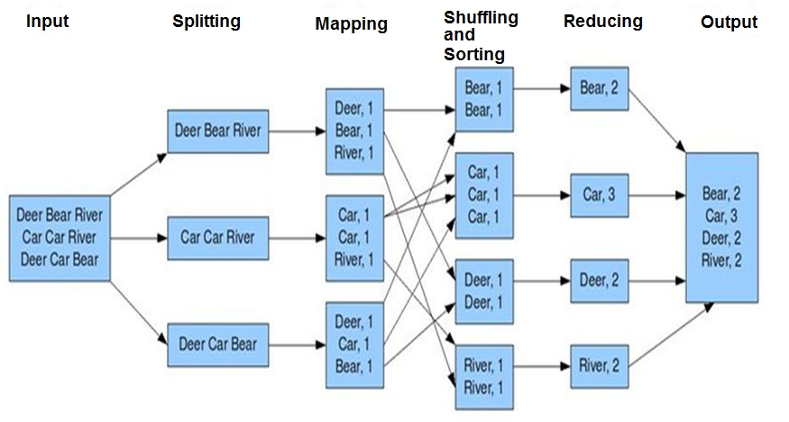
MapReduce

Slide 12
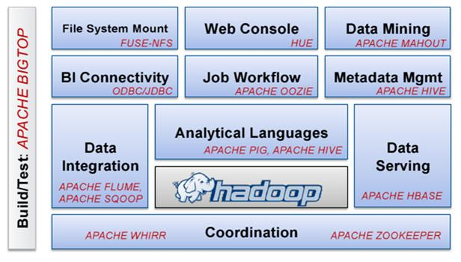
Utilities

Slide 13
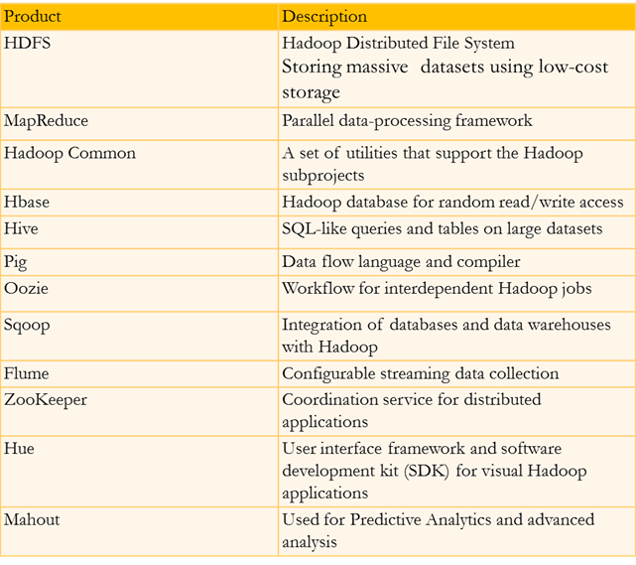
Brief description of all Utilities

Slide 14
Benefits of Hadoop
No huge bandwidth required.
Each node performs its task in near isolation so scaling up and down is not an issue.
Partial failure are not difficult to handle as if a node goes down, the JobTracker schedules the task on some other node without impacting the job.

Slide 15










Hadoop Job Processing

Slide 16
Demo….
Word Count example
MapReduce program
Operations through Hive
Operations through Hbase
Operation through Sqoop

Slide 17
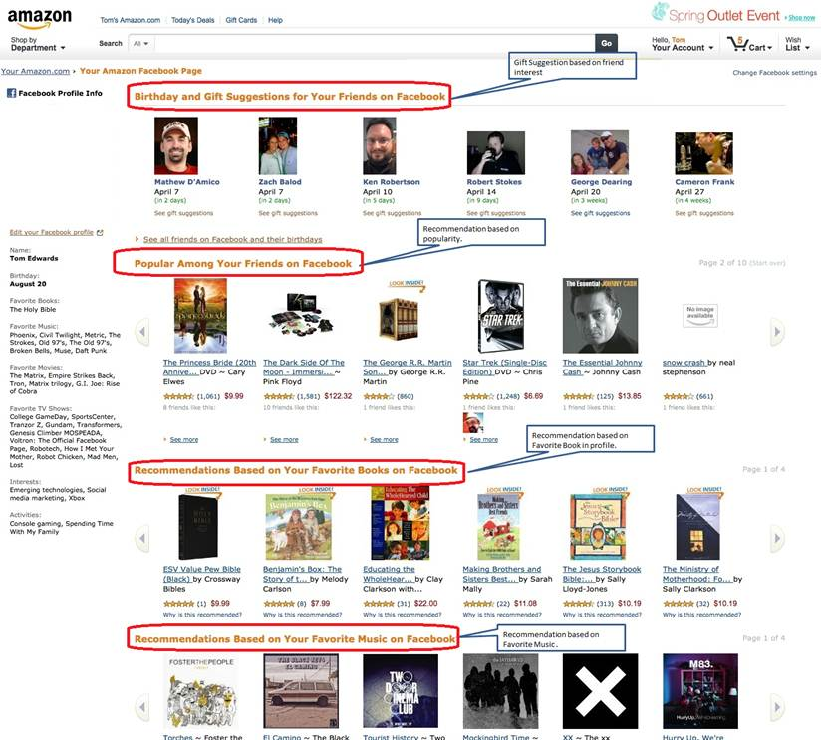
Real Time Examples: Recommendations

Slide 18
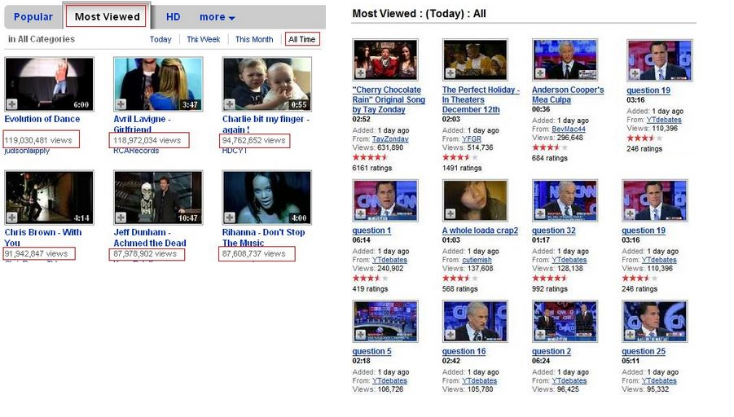
Recommendations (Continue..)

Slide 19
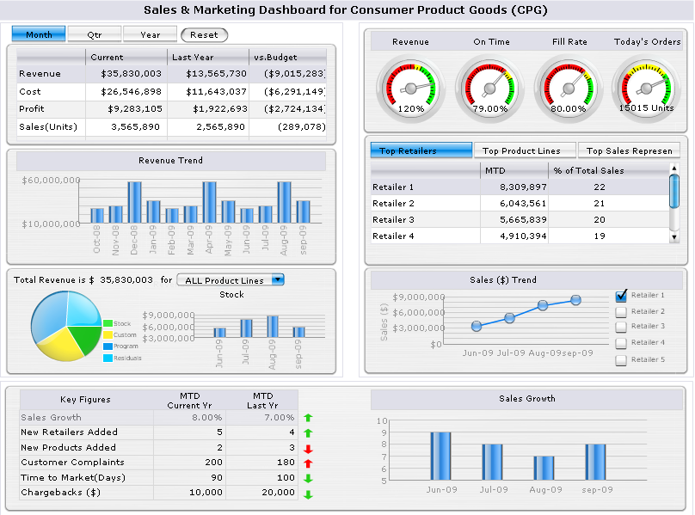
Faster Data Analysis and Reporting :

Slide 20

The Most Imp BigData Storage :

Slide 21

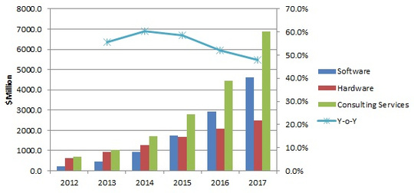
Hadoop is Growing Abnormally….

Slide 22
Thank you!

